Slide 1

Sitecore 9.3 Training Day - 3
Balaji Balasubramanian

Slide 2
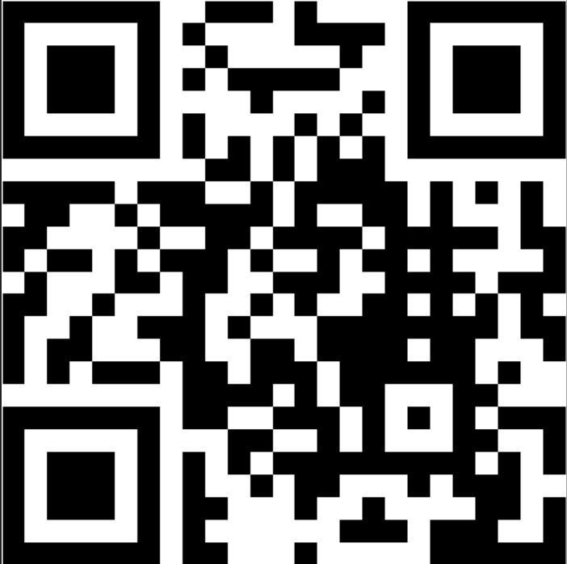
Survey
About your Sitecore experience
https://www.menti.com/z5fkfymrk4
Or
Go to www.menti.com and use the code 7029 4013
Or
Scan the QR Code

Slide 3
Agenda
User, Roles & Workflow
What's the need for the workflow ?
Live session on configuring workflow to the existing template
Live session on creating roles and user
Assigning permissions to the roles
Assigning the user to the roles
Workflow Approval – Final Validation Errors
Live demo –
Sample Workflow
Draft
Submit
OnSave
Awaiting Approval
Approve
Reject

Slide 4


Workflow
Sitecore User & Role
User : UserBlogAuthor
Role : RoleBlogAuthor
User : UserBlogApprover
Role : RoleBlogApprover

Slide 5
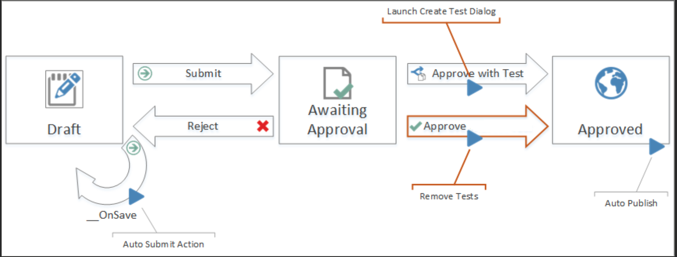
Workflow
Sitecore Sample workflow

Slide 6
Thank you

